Slide 1


William Mansell
March 2024

Slide 2

Outline
Executive Summary
Introduction
Methodology
Results
Conclusion
Appendix

Slide 3
Executive Summary
Summary of methodologies
Data Collection and Wrangling
Exploratory Data Analysis & Data Visualization
Exploratory Data Analysis using SQL
Building an interactive map with Folium
Building a Dashboard with Dash – Plotly
Predictive Analytics & Modeling
Summary of all results
Collection, Wrangling, Exploration results
Predictive Analytics results

Slide 4
Introduction
Project background and context
SpaceX is a successful corporation in the commercial space, with a focus on making space travel affordable. This company advertises Falcon 9 rocket launches costing $62M – the nearest competitor costing upwards of $165M. This is accomplished through reuse of the first stage of launch.
If we can determine if the first stage will land, we can then determine the cost of a launch using a variety of data science methods.
Problems you want to find answers
How do variables such as payload mass, launch site, number of flights, orbits, and others impact the success rate of the first stage landing?
What is the best algorithm that can be created and leveraged for binary classification of success?

Slide 5

Section 1

Slide 6
Methodology
Executive Summary
Data collection methodology:
We leveraged web scraping from Wikipedia combined with the SpaceX API
Perform data wrangling
We filtered the data to relevant data points and eliminated missing values
Leveraged various techniques such as One Hot Encoding to prepare the data for binary classification
Perform exploratory data analysis (EDA) using visualization and SQL
Perform interactive visual analytics using Folium and Plotly Dash
Perform predictive analysis using classification models
Build, tune and evaluate the classification models that led to best results from our analysis

Slide 7
Data Collection
Data sets were collected using a combination of API requests from SpaceX and web scraping data from the Wikipedia site. This combination allowed for complete information about the launches, providing us with necessary knowledge for a more detailed analysis
Data Columns utilized from SpaceX API:
FlightNumber, Date, BoosterVersion, PayloadMass, Orbit, LaunchSite, Outcome, Flgihts, GridFins, Resued, Legs, LandingPad, Block, ReusedCount, Serial, Longitude, Latitude
Data Columns utilized from Wikipedia Page Web Scraping:
Flight No., Launch Site, Payload, PayloadMass, Orbit, Customer, Launch Outcome, Version Booster, Booster Landing, Date, Time

Slide 8
Data Collection – SpaceX API
Requesting rocket launch data
Decoding data using .json and normalizing
Requesting information about launches from SpaceX API
Constructing received data into dictionary
Creating dataframe from dictionary
Filtering dataframe to results only for Falcon 9
Replace missing values where applicable
Exporting data to CSV format
Data Collection API

Slide 9
Data Collection - Scraping
Requesting Falcon 9 data from Wikipedia
Leveraged BeautifulSoup for HTML
Extracted all columns
Collected and analyzed the data
Input data into dictionary
Created a dataframe from dictionary
Exporting data to CSV format
Data Collection via Web Scraping

Slide 10
Data Wrangling
Performed exploratory analysis to derive training labels
Calculate number of launches
Calculate orbits
Calculate mission outcome per orbit
Create landing outcome label
Export Data to csv
Data Wrangling

Slide 11
EDA with Data Visualization
Several visualization charts were plotted to derive insights:
Flight Number vs Payload Mass
Flight Number vs Launch Site
Payload Mass vs Launch Site
Orbit Type vs Success Rate
Flight Number vs Orbit Type
Payload Mass vs Orbit Type
Success Rate Yearly Trend
Scatter plots were used to show the relationship between variables
Bar charts were used to show comparisons amongst categories
Line charts were used to show trends over time
EDA with Data Visualization

Slide 12
EDA with SQL
Utilized several SQL queries for data exploration:
Display names of each distinct launch site
Displayed rows of data where launch sites began with ‘CCA’
Displayed total payload mass carried by boosters
Displayed average payload mass carried by booster ver. F9 v1.1
Date when the first successful landing outcome occurred
Listing names of boosters which have drone ship success between payload thresholds
Etc…
EDA with SQL

Slide 13
Build an Interactive Map with Folium
Folium Map Markers
Added circle markers, pop-up labels, and text labels using latitude and longitude coordinates
Added circle markers, pop-up labels, and text labels using latitude and longitude coordinates to show geographical locations
Launch Outcomes for each Site
Colored markers of success [green] and unsuccessful [red] launches using markerclusters to identify success rates for each site
Distances Between Launch Sites
Colored lines to show distances between various launch sites
Interactive Map with Folium

Slide 14
Build a Dashboard with Plotly Dash
Pie Chart showing successful launches
Slider of payload mass range
Scatter Chart of payload mass vs success rate for the different booster versions
Unfortunately, this was the only part of the analysis that didn’t bear fruit, as the tools were not functioning properly

Slide 15
Predictive Analysis (Classification)
Created numpy array for “class” data
Standardized the data with StandardScaler
Transformed the data and then “fit” it
Split the data into a training set and a testing set
Created a GridSearchCV to establish the best parameters
Used LogReg, SVM, Decision Tree, and K-N models
Calculating accuracy across various variables to determine best model
Developed and applied confusion matrix for each model
Found the best model based on Jaccard Score and F1 Score functions
Machine Learning Prediction

Slide 16
Results
Exploratory data analysis results
Interactive analytics demo in screenshots
Predictive analysis results

Slide 17

Section 2

Slide 18
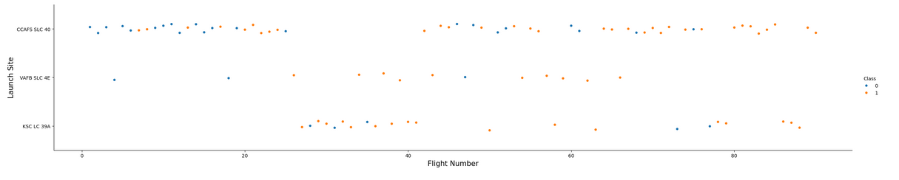
Flight Number vs. Launch Site
Earliest flights failed; later flights succeeded
CCAFS SLC 40 launch site has majority of launches
VAFB SLC 4E has a high success rate. KSC LC 39A is mediocre

Slide 19
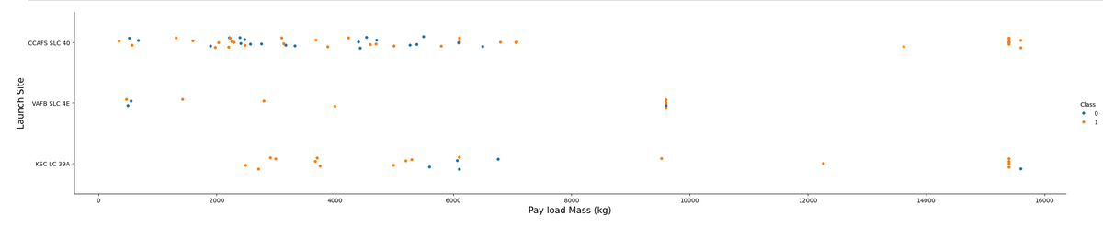
Payload vs. Launch Site
Launch sites with a larger payload mass have a higher success rate
Majority of launches with payloads >= 6500 were successful, with few outliers
KSC LC 39A almost 100% successful after 6500 payload

Slide 20
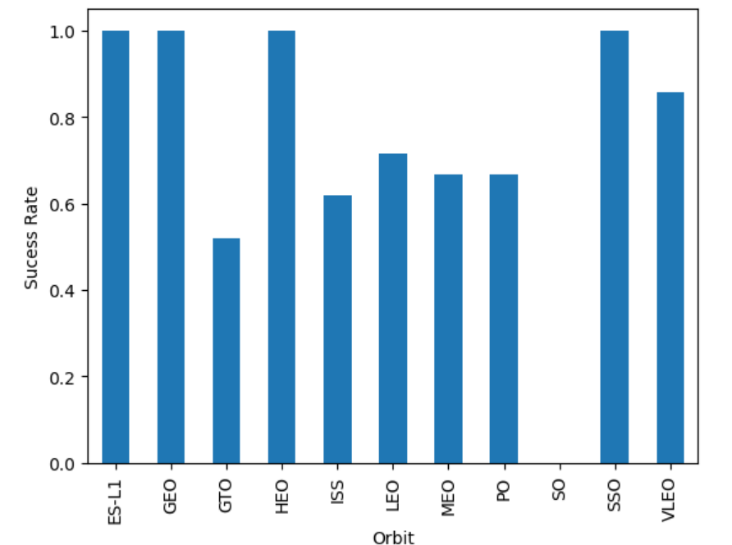
Success Rate vs. Orbit Type
ES-L1, GEO, HEO have 100% success rates.
SSO is very close
SO has a 0% success rate – recommend removing orbit
Remainder have greater than 50%

Slide 21
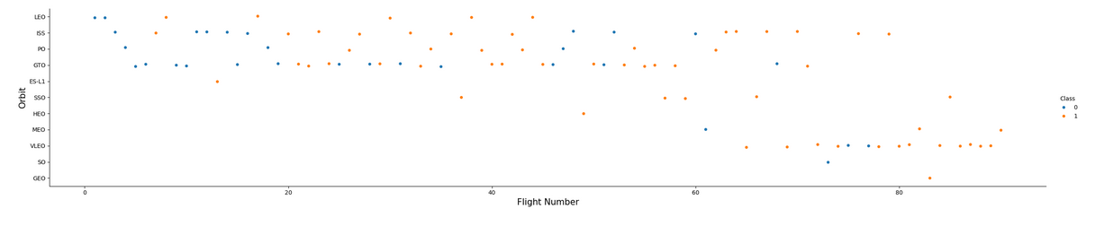
Flight Number vs. Orbit Type
LEO Orbit success appears related to the number of flights
No relationship gleamed from GTO Orbit

Slide 22
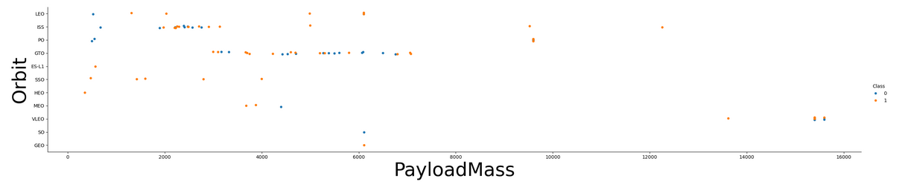
Payload vs. Orbit Type
Heavy payloads impact the successful landing and positive landing rates for POLAR, LEO and ISS
GTO has both positive and negative landing rates
I used bigger font for the axes because I felt like it I guess

Slide 23
Launch Success Yearly Trend
Notated that the success rate since 2013 kept increasing until 2020
Unable to develop chart to reflect these findings due to error

Slide 24
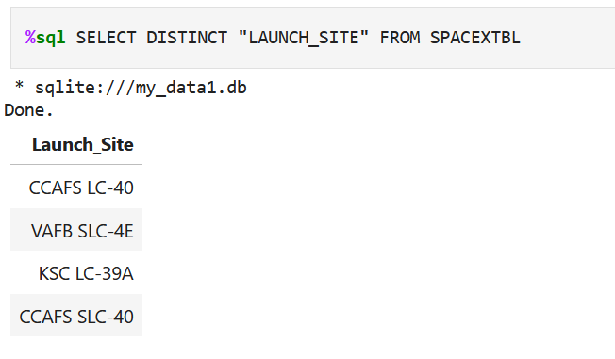
All Launch Site Names
SQL query that selects distinctly unique launch site names from the database

Slide 25
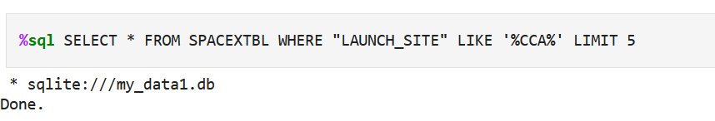
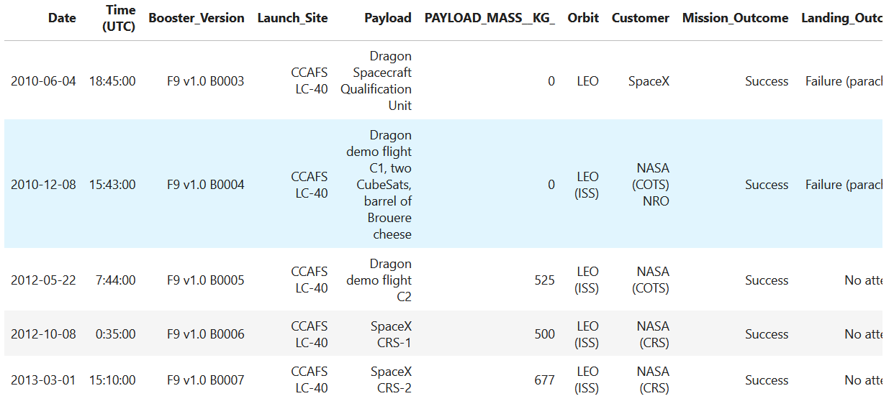
Launch Site Names Begin with 'CCA'
SQL query selects 5 rows from the database where the launch sites begin with the character string ‘CCA’

Slide 26
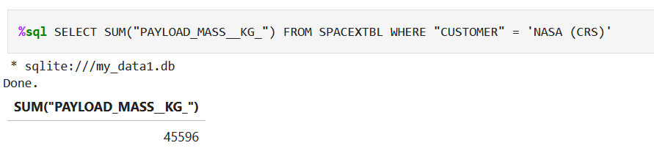
Total Payload Mass
SQL query calculates the sum of the payload mass column where the customer is NASA (CRS)

Slide 27
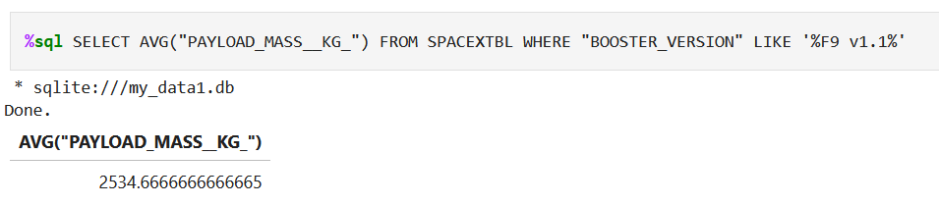
Average Payload Mass by F9 v1.1
SQL query calculates the average of the payload mass from the database where the booster version is F9 v1.1

Slide 28
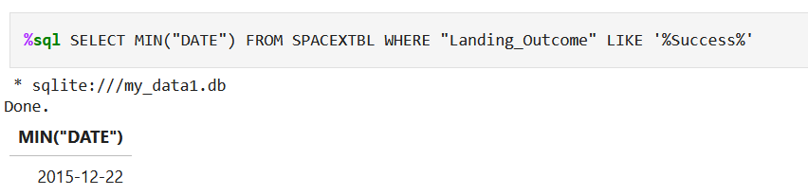
First Successful Ground Landing Date
SQL query derives the first successful landing date by leveraging the “min” function

Slide 29
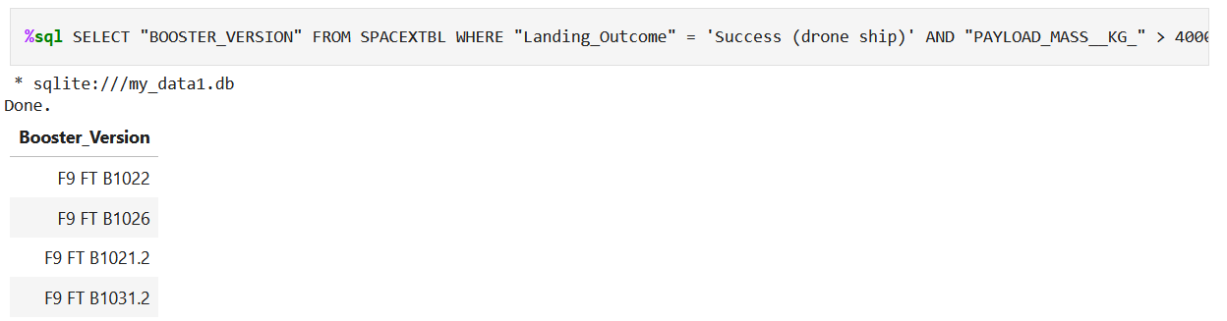
Successful Drone Ship Landing with Payload between 4000 and 6000
SQL query selects the booster version column from the database where the landing outcome column reflects “success (drone ship), but only if the Payload column is between 4000 and 6000

Slide 30
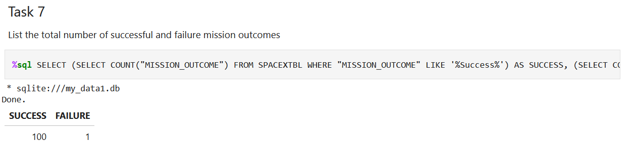
Total Number of Successful and Failure Mission Outcomes
SQL query selects the count of how many successful mission outcomes there were, along with how many failures

Slide 31
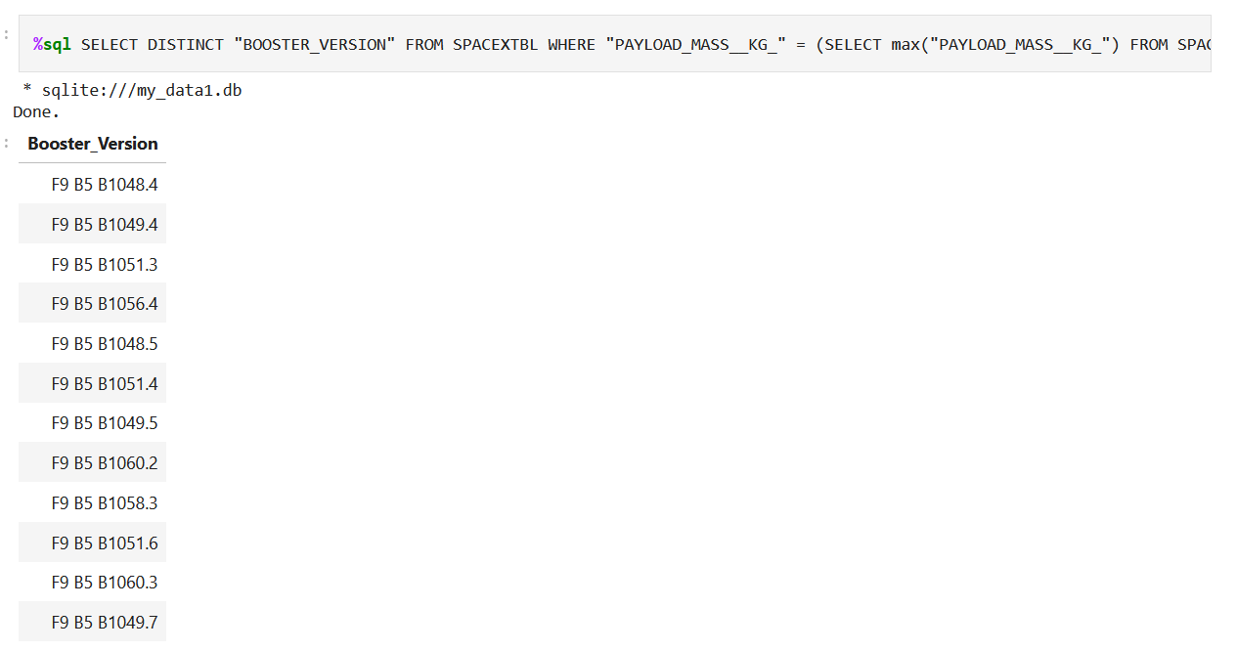
Boosters Carried Maximum Payload
SQL query selects unique booster version rows from the database where the payload column is the maximum value

Slide 32
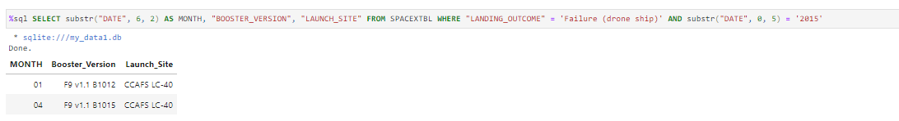
2015 Launch Records
SQL query shows the month, booster version and launch sites with failed landings in 2015

Slide 33
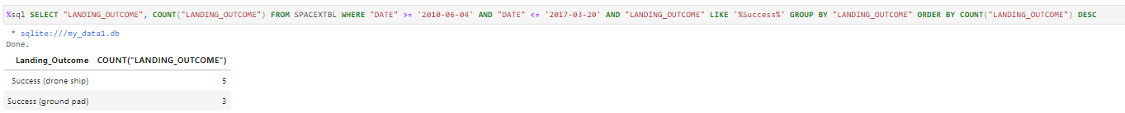
Rank Landing Outcomes Between 2010-06-04 and 2017-03-20
Rank the count of landing outcomes (such as Failure (drone ship) or Success (ground pad)) between the date 2010-06-04 and 2017-03-20, in descending order

Slide 34

Section 3

Slide 35
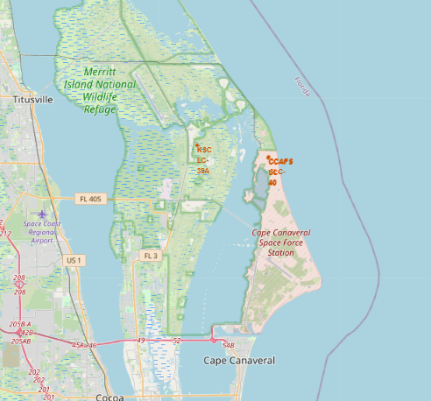
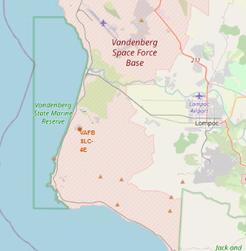
Folium Map 1

Slide 36
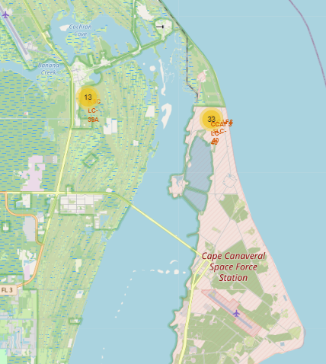
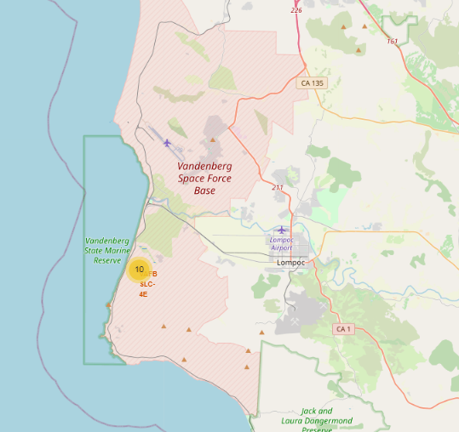
Folium Map 2

Slide 37
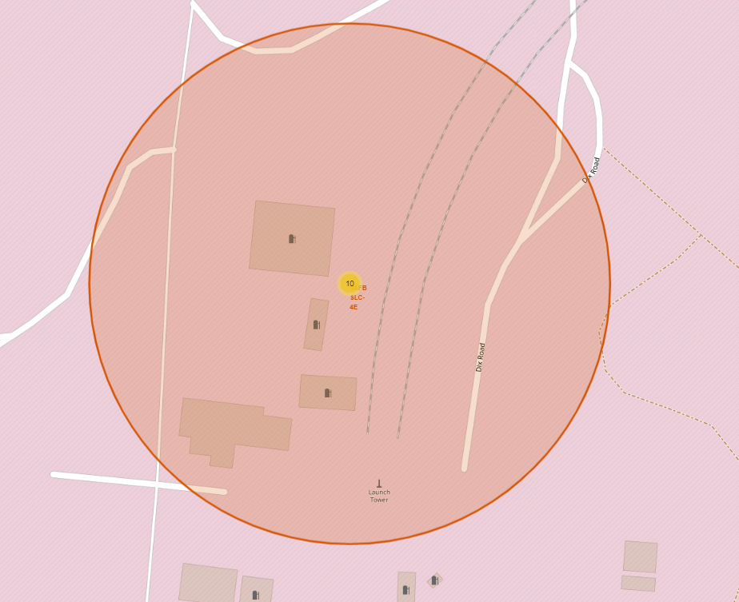
Folium Map 3

Slide 38

Section 4

Slide 39
Plotly Code
Provided software did not work – link below to code
Link to code

Slide 40

Section 5

Slide 41
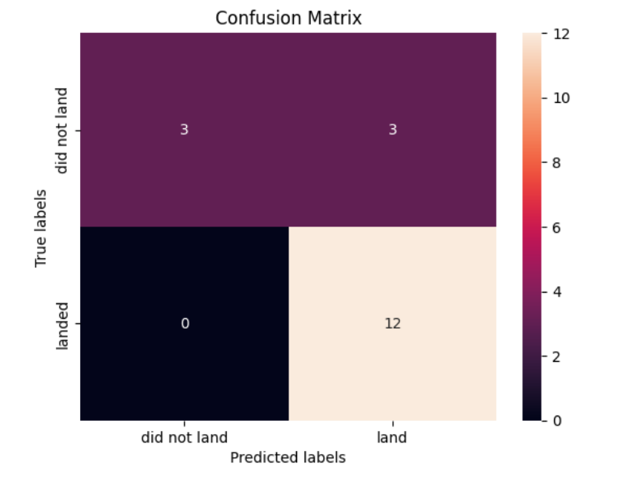
Confusion Matrix
SVM model had the most accurate confusion matrix, with an accuracy of 83.33%

Slide 42
Conclusions
We’ve leveraged many data science techniques to delve deeper into the relevant data to determine how to approach our competition with a price that cannot be beaten, while ensuring our data backs up our claims pertaining to first stage success of launch.

Slide 43


